Slide 1

Bay 3, Stage 3 Summer Slam 9 Course Designer: Marcel Englmaier
Summer Slam 9 is a 24 round, 120 point Comstock Long course. There are 12 IPSC targets. The best two hits per target will score. The start signal is audible.
The Handgun start position is standing anywhere in the shooting area with wrists below belt. Handgun is loaded and holstered. The PCC start position is standing anywhere in the shooting area with PCC stock on belt, muzzle pointing downrange, and safety on.
On the audible start signal, engage all targets from behind the fault lines.

Slide 2
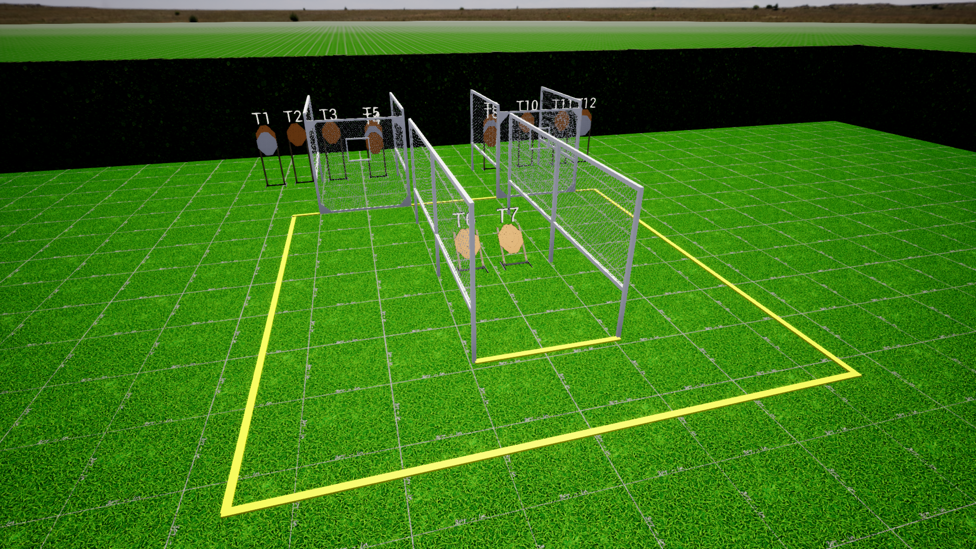
 | Stage 3 Summer Slam 9 Course Designer: Marcel Englmaier

